Slide 1
Risk Management

Slide 2



Introduction
What is Risks?
What is Risk Management?
Risk Management Steps
Plan Risk Management
Identify Risks
Analyze Risks
Plan Risk Responses
Monitor and Control Risks

Slide 3

What is
Risk?
Risk Appetite?
Risk Tolerance?
Risk Management?
Risk management can be defined as the identification, assessment, and prioritization of risks followed by coordinated and economical application of resources to minimize, monitor, and control the probability and/or impact of unfortunate events or to maximize the realizations of positive risks

Slide 4
Risk Management
Identification of Risks
Assessment of Risks
Prioritization of Risks
minimize
control
monitor
Probability and/or impact of unfortunate events
RESOURCES
Realization of Opportunities
maximize

Slide 5
Risk Management principle
Create value
Be an integral part of organization’s processes
Be a part of decision making processes
Be systematic and structured
Be transparent
Be responsive to change
Be capable of continual improvement and enhancement
Continually-periodically re-assess

Slide 6
Risk management process
Plan Risk Management
Identify Risks
Analyze Risks
Plan Risk Response
Monitor & Control
RISK MANAGEMENT STEPS

Slide 7
Plan risk management
Specifies the management intent, systems and procedures required
Provide definitions of various risk related terms, roles and responsibilities related to risks, tools and templates
In a way it specifies how the next four steps in risk management are executed

Slide 8
Identify risks
It is the key step in actual management of risks
Identifying potential risks, their root causes and its consequences
Group effort- subject matter experts from various groups
Common tool – brainstorming
No identified risks will be evaluated or criticized
Other tools Ishikawa diagram, flow diagram, SWOT analysis

Slide 9
Analyze RISKS
Limited Resources – there for analyze and prioritize risks
Some may need Action Plan and few others may require Periodic Monitoring
It is the process of quantifying the risk events
Risk analysis – Qualitative or Quantitative
Qualitative – Subjective- quick and easy to perform (ex. Probability and impact matrix)
Quantitative is detailed analysis and is not required for all (ex. Expected monetary value analysis, Monte Carlo analysis, Decision trees.

Slide 10
Probability and impact matrix
Qualitative analysis tool.
Two aspects 1) Probability the risk will happen 2) Potential impact if the risk happens
Risk Score = Probability x Impact
Organization creates guidelines for example
9- Very High – Risk event expected to occur
7- High – Risk event more likely to occur
5- Probable – Risk may or may not occur
3- Low – Less likely to occur
1- Very low – Not expected to occur
Low Impact
High Probability
High Impact
High Probability
Low Impact
Low Probability
High Impact
Low Probability
Risk may impact- cost, schedule, scope, quality
Fig 1- Sample Impact Table

Slide 11
Risk Response
Negative Risk
Avoid
Mitigate
Transfer
Accept
Positive Risk
Exploit
Enhance
Share
Accept

Slide 12
Methods of describing project risks
We may analyze project risk by first determining the uncertainty inherent in a project’s cash flows.
Simple informal judgements to complex economic and statistical quantities.
Sensitivity Analysis
Breakeven Analysis
Scenario Analysis
Probability Techniques – Monte Carlo Simulations and Decision Trees
Other approaches of Modelling and Simulations

Slide 13
Sensitivity analysis
Get glean a sense of possible outcomes of investment
Effect on NPW for variations in the input variables (ex. Revenues, operating costs, salvage value etc.)
How much NPW will change for a given change in input variable.
Results may imply
Some items may have greater influence on final results,
In some cases most significant item may be identified
For example: 1) Sales volume is always critical or
2) Find items that has significant influence – can be subjected to scrutiny (“What-if” analysis).
It Begins with Base Case Analysis

Slide 14
Break-even analysis (BEA)
In sensitivity we asks How serious the effect of lower revenues or higher costs
Sometimes managers may prefer how much sales can decrease below forecast before the project begins to loose money.
BEA is a technique for studying the effect of variations in output on a firms NPW or other measures.
Here,
PW of cash flows as a function of unknown variable ‘x’.
PW of cash inflows = f(x)₁; PW of cash outflows = f(x)₂
Break-even value (x) implies f(x)₁ ₌ f(x)₂

Slide 15
Scenario analysis
Sensitivity and Break-even has limitations- Difficult to specify precisely the relationship between particular variable and NPW.
Interdependencies between variables and its effect on NPW is different.
For example Operating costs constant we may vary unit sales for ease in analysis but actual behavior?
Scenario analysis is a technique that considers the sensitivity of NPW both to changes in key variables to the range of likely values.
For example two extreme case ( Worst case scenario and Best case scenario)

Slide 16
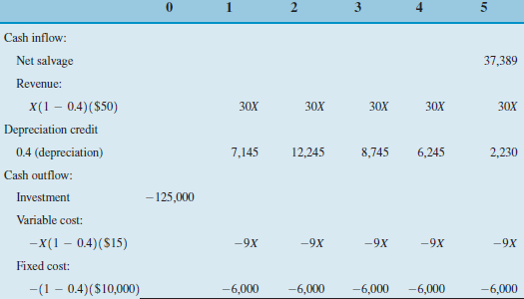
Example – for Break-even analysis
PW of Cash Inflows = PW of Cash Outflows

Slide 17
Examples

Slide 18
PW (15%) Inflows = (PW of after tax net revenue) + (PW of net salvage value) + (PW of tax savings for depreciation)
= 30X (P/A, 15%, 5) + 37389 (P/F, 15%, 5) + 7145 (P/F, 15%, 1) + 12245 (P/F, 15%, 2) + 8745 (P/F, 15%, 3) + 6245 (P/F, 15%, 4) + 2230 (P/F, 15%, 5)
= 100.5650X + $44,490
PW (15%) Outflows = (PW of Capital Expenditure) + (PW of after-tax expenses)
= 125,000 + (9X + 6000) (P/A, 15%, 5)
= 30.1694X + $145,113
Now Equate for X,
X = 1,430 units.

Slide 19
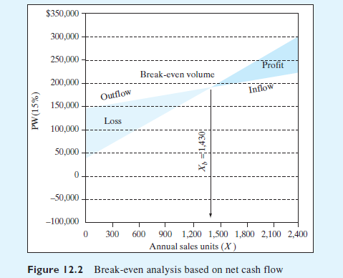
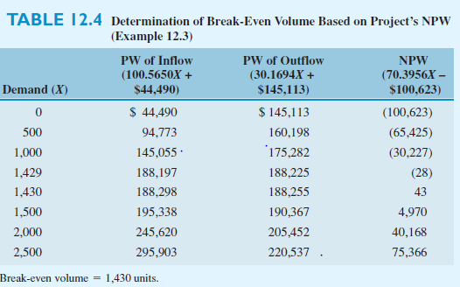

Slide 20
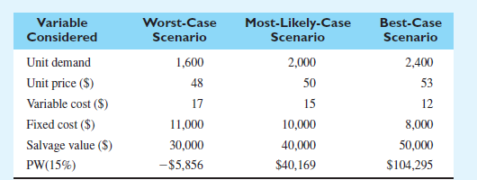
Scenario Analysis

Slide 21
Thank you!!!

